Slide 1
Biomechanics Project A simple algorithm capable of stable gait in a noisy environment?
Joao Fonseca Reis – CMU MRSD
December 2018

Slide 2

Motivation: A simple algorithm capable of stable gait in a noisy environment?
High locomotion speed
Low vertical peak forces
Low or slowly changing instabilities
Resilient to “noisy” terrain
“General” enough (so that you don’t just design your machine for walking)

Slide 3
Most legged locomotion algorithms focus on each leg independently (not on joint behaviour)
BACKGROUND
Non-exhaustive
Control | Examples of legged locomotion papers | Algorithms using Spring Mass Model
Independent Legs | The spring mass model for running and hoping (R. Blickhan, 1989) | One massless leg + Point mass body Variable Angle of Attack for touchdown
 | Touch-down angle control for spring-mass walking (H Geyer, 2015) | Two massless legs + Point mass body Variable Angle of Attack for touchdown Deadbeat control policy for perturbations
Inter-Dependent Legs | Grounded running in quails: Simulations indicate benefits of observed fixed aperture angle between legs before touch-down (E. Andrada, 2013) | Two massless legs + Point mass body Fixed Angle of Aperture between legs
 | Trunk orientation causes asymmetries in leg function in small bird terrestrial locomotion (E. Andrada, 2017) | Two massless legs + Rigid body trunk Parallel spring and dumper model Fixed Angle of Aperture between legs

Slide 4
The algorithm used is a fixed aperture angle between the two legs while a leg is in the flight phase
THE MODEL (1/2)
Each leg is a spring of equal stiffness
The algorithm
Both legs flying | Falling body under gravity field (leading leg with 90 angle of attack)
One leg in the air | One foot on the ground with no slippage, not controlled by the algorithm Another foot at angle F measured from the leg in stance
Two legs in stance | Algorithm takes no action whatsoever
m
K_{L}
g
K_{R}
F
m = 80 kg, Kr=Kl=12,000 N/m, g=9.81 m/s^2, l0= 1 m
F = fixed control

Slide 5
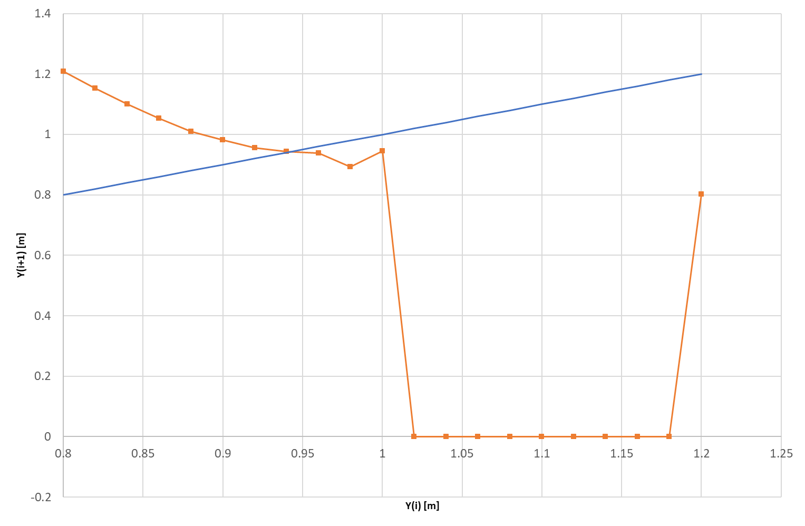
The strategy used for looking for stable gaits was plotting Poincare maps
The model (2/2)
Define Success
Y(i)=Y(i+1) | Which means it is periodic!
Slope in Poincare map <1 (in module) | Which means it is stable!
Energy elastic = 0 at i+1 | Which means the spring did not “fail to release the ground”
A simple example with one Energy and one F
1
The good area…
3
A flying solution!!!
2
.. is very close to the bad!
Used in simulation: E0= 1,665 Joules, F= 20 degrees

Slide 6
A “good operating band” delivers a single stable walking gait over several aperture angles but…
RESULTS OBTAINED SO FAR (1/4)
Success rate across multiple initial conditions
Initial conditions | y0 -->
Vx0 | 0.8-0.9 | 0.9-1 | 1-1.1 | 1.1-1.2 | Total Geral
0-1 |  | 0.0% | 21.2% | 0.0% | 7.1%
1-2 | 0.0% | 0.7% | 0.2% | 0.0% | 0.3%
2-3 | 0.0% | 3.4% | 0.0% | 0.0% | 0.7%
3-4 | 0.0% | 12.5% | 0.0% | 0.0% | 3.1%
4-5 | 0.0% | 8.8% | 0.1% | 0.2% | 2.2%
5-6 | 0.0% | 6.8% | 0.1% | 0.3% | 1.7%
6-7 | 0.0% | 8.3% | 0.2% | 0.2% | 2.5%
Total Geral | 0.0% | 7.0% | 0.9% | 0.2% | 2.0%
[M]
Ex: 1,266 J
[m/s]
Successful cases are mostly stationary solutions (Vx0(i)=0)
Note: Scan done for 20 heights (.8 to 1.2 m), 20 energies, 90 different F (in a total of 36,000 runs)

Slide 7
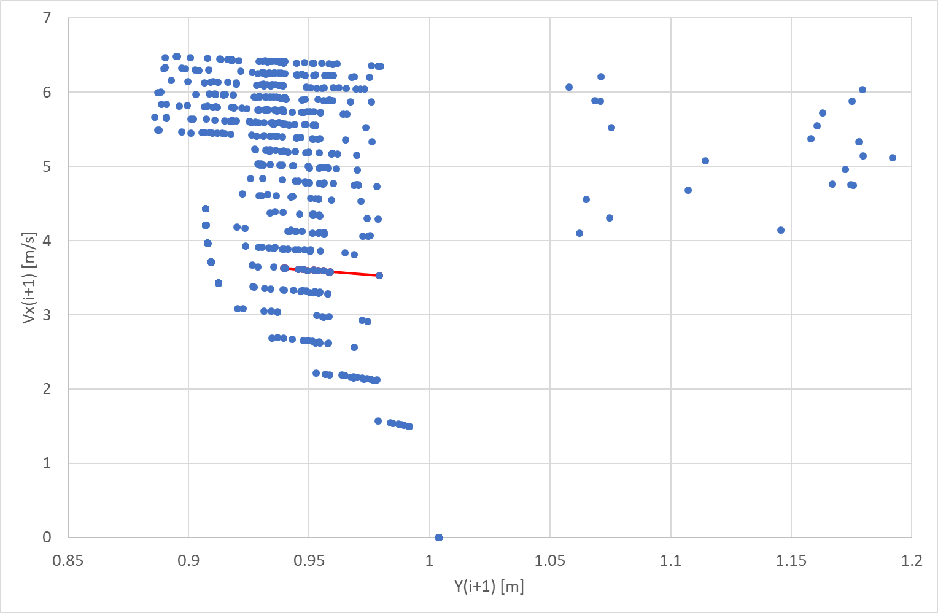
… there this band has no non-grounded running solutions!
RESULTS OBTAINED SO FAR (2/4)
Plotting the success cases
1
Each “line” is an energy band
(each point a different F)
2
Very few “flying solutions”
The 1,266 J energy band has no flight solutions!
3
The stationary solution (and backwards walking not shown)

Slide 8
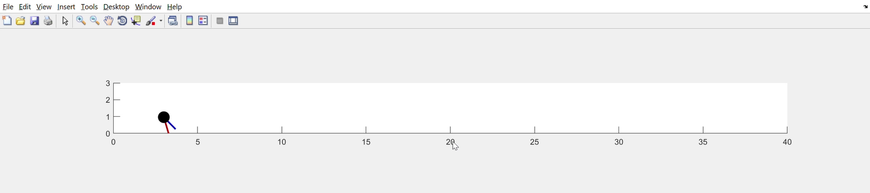
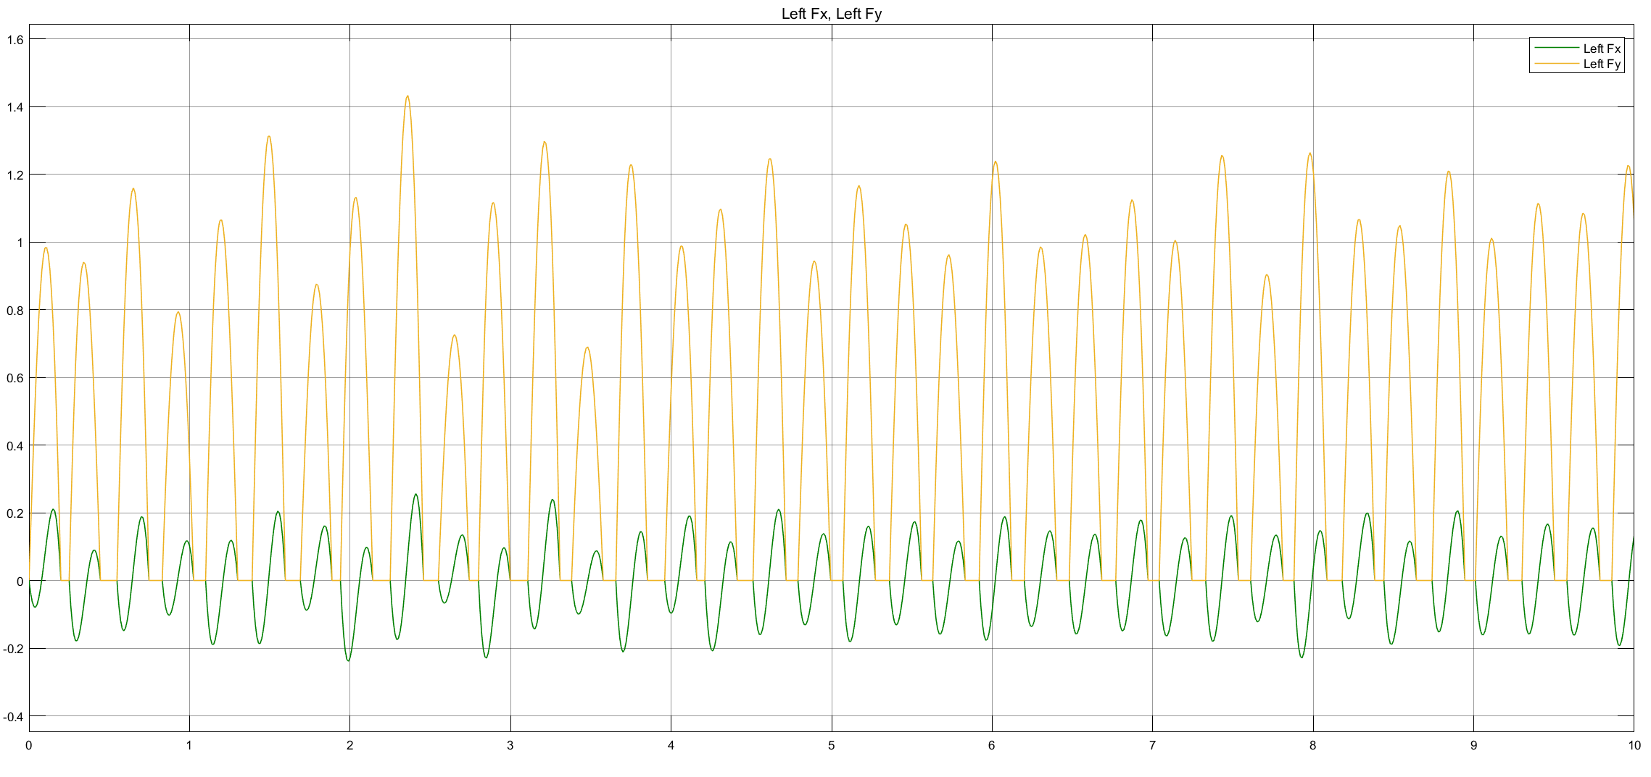
Stability may be achieved through irrational periods, which may not be our first choice but deliver long stable walking periods
RESULTS OBTAINED SO FAR (3/4)
Example for the 1,226 J band
[m]
[m]
Leg Forces ratio to robot weight (left leg)
F/(m*g)
s
Simulation parameters: m = 80 kg; g = 9.81 m/s^2; kR = kL=12,000 N/m; l0 = 1 m; Vx0=3.58 m/s; y0=0.96 m; phi0=28 degrees; x0 = 3 m; Vy0 = 0 m/s; yG=0 m;

Slide 9
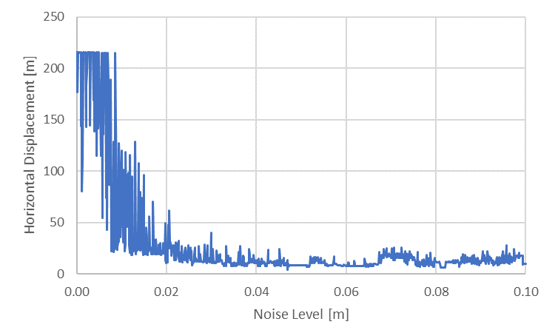
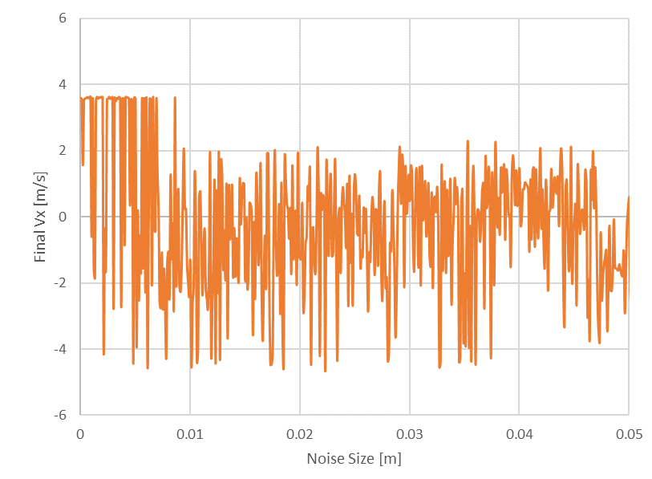
When noise is introduced, walking time is more resilient than the final horizontal speed achieved
RESULTS OBTAINED SO FAR (4/4)
Horizontal displacement for constant noise levels
Final horizontal speed for constant noise levels
2
… and sometimes the robot finishes walking backwards!
1
Travelled distance falls fast..
427 steps
27 steps
Note: By default simulation was always stopped at t=60 s even when the robot had not fallen. 1000 different noise levels were tested.
Noise sampling time: 0.1 s, with noise introduced over the entire simulation

Slide 10
RESULTS COMPARISON against literature
 | Results from literature (highlighted paper) | Results against literature simulations
Forces Symmetry | Symmetric vertical forces¹ | In line
Stable solutions | Most of the stable solutions for grounded running | In line (additionally, a stable band may not have any non-grounded stable solution)
Leg Compression | Ratio 1.05 to 1.71 to body weight (BW) | Broadly in line (0.7 to 1.41 BW for different K/m)
Noise resilience (10% leg size) | > 50 steps under single step-up / step down | In line: 27 steps under constant noise equivalent (but possible to have final Vx<0)
Solution Periodicity | Not discussed | Irrational period possible in a stable energy band
¹ Nonetheless, experimental data shows positively skewed flattened half-sine pattern) which drives the motivation of the second paper from the same author
Note: While the presented simulations ran for 60 seconds, the literature presentations ran for up to 50 steps

Slide 11
NEXT STEPS
Future work may focus on
Introducing variable stiffness through feed-forward leg placement or muscle pre-activation (as most legged animals do when the adjust their gait)
Introducing the ability to add/subtract energy from the system through actuation (enabling for example our robot to go up and down a ramp)
Finding analytically when a gait will be stable/periodic (even if we don’t know where the apex will be located)
Predicting analytically apex points for any initial condition (e.g. planets XYZ orbits are well defined although until today it is impossible to derive a time dependent equation)

Slide 12
BACKUP

Slide 13
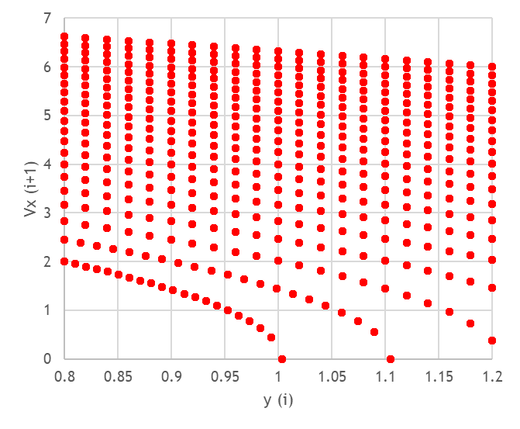
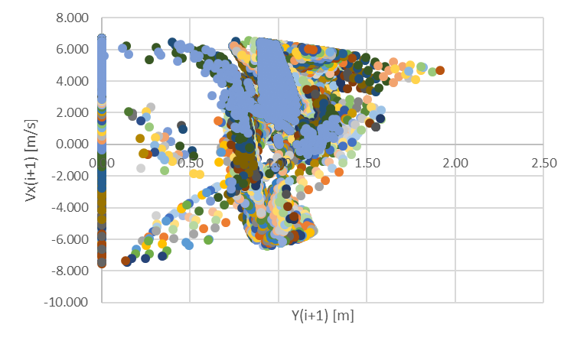
First attempt: Brute Force for initial conditions with different height, different speed in x, apex in y
How important is it to have a good predictable model FOR walking dynamics?
Scan the initial conditions where we want to operate in…
… iterate until the next apex is reached (or the ground)
1
Straight down!
2
Did “something”?
m/s
3
Went backwards?
m
Note: Each color is a different F
Note: Scan done for 20 heights (.8 to 1.2 m), 20 energies, 90 different F (in a total of 36,000 runs)

Slide 14


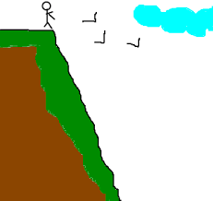
Contiguous initial conditions can result in massively different outcomes: (deterministic) chaos?
Maybe I am not so confident anymore….
The apple never falls too far from the tree…
… except when it does so… MASSIVELY !!!!

Slide 15
